Slide 1

Progress check
ADRUTI ONAM

Slide 2
Projects
Table Generation
Guardrails 2.0
R&D for NLP Based algorithms for analyzing different use-cases.
Projects having similar use cases can adopt these functionalities instead of creating their own.
It is an NLP Based Product made using Python, AWS and Vue.​
It helps the encore generator team to perform tasks in a faster and smarter way.
Tasks such as Summarization and Translation are simplified. ​
Notes:
Section Divider with Two Copy Content

Slide 3
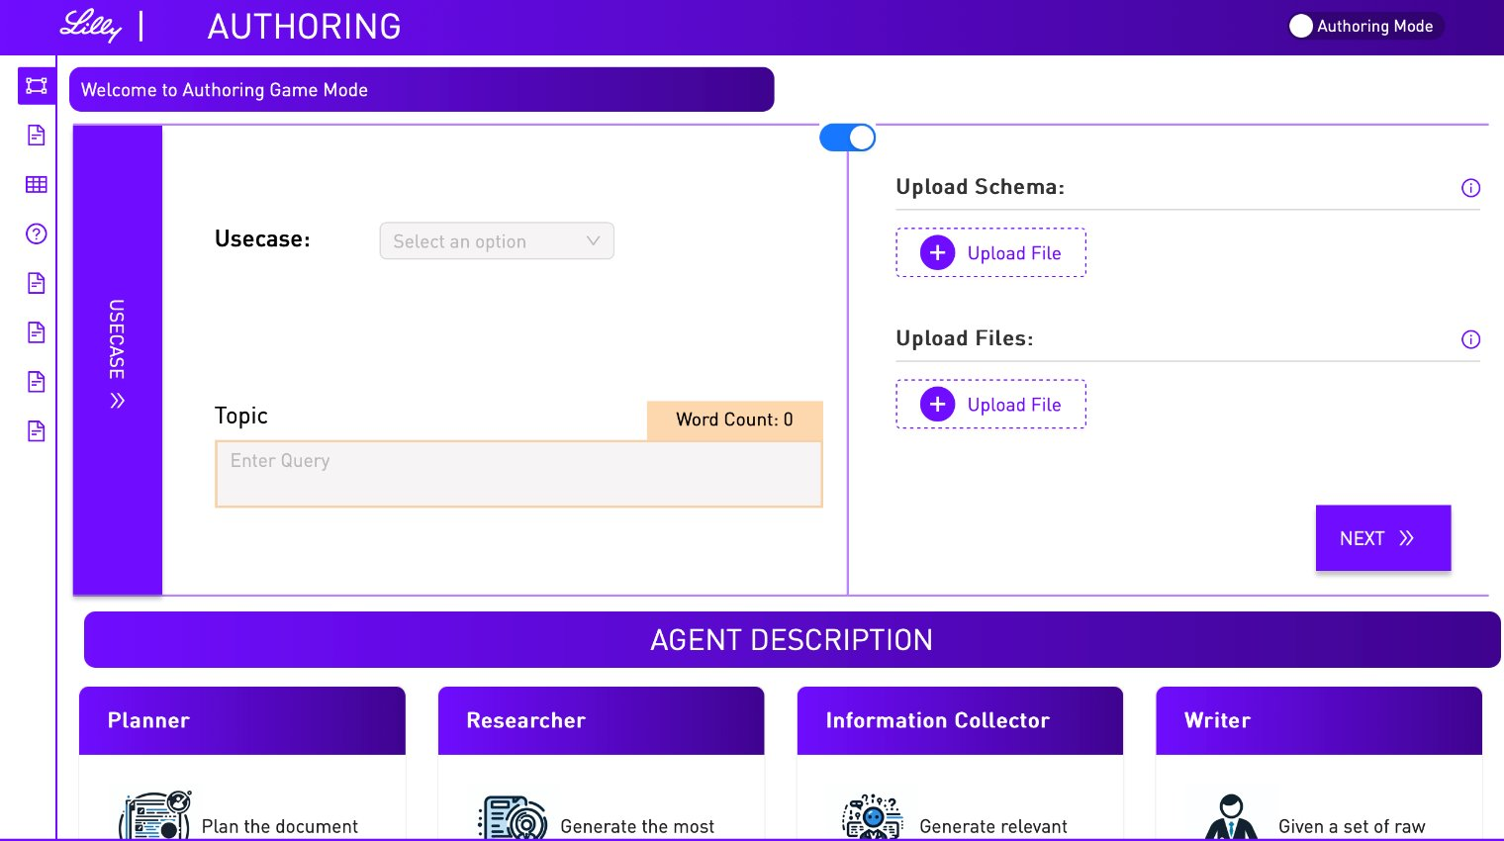
Vue.js
Toggle Features
Implemented a toggle button feature that dynamically controls the display of cards, enabling users to seamlessly access Authoring Studio functionalities.
This enhancement allows users to upload files and schemas, improving flexibility and streamlining content management.
Reduces manual steps by enabling seamless file and schema uploads.

Slide 4
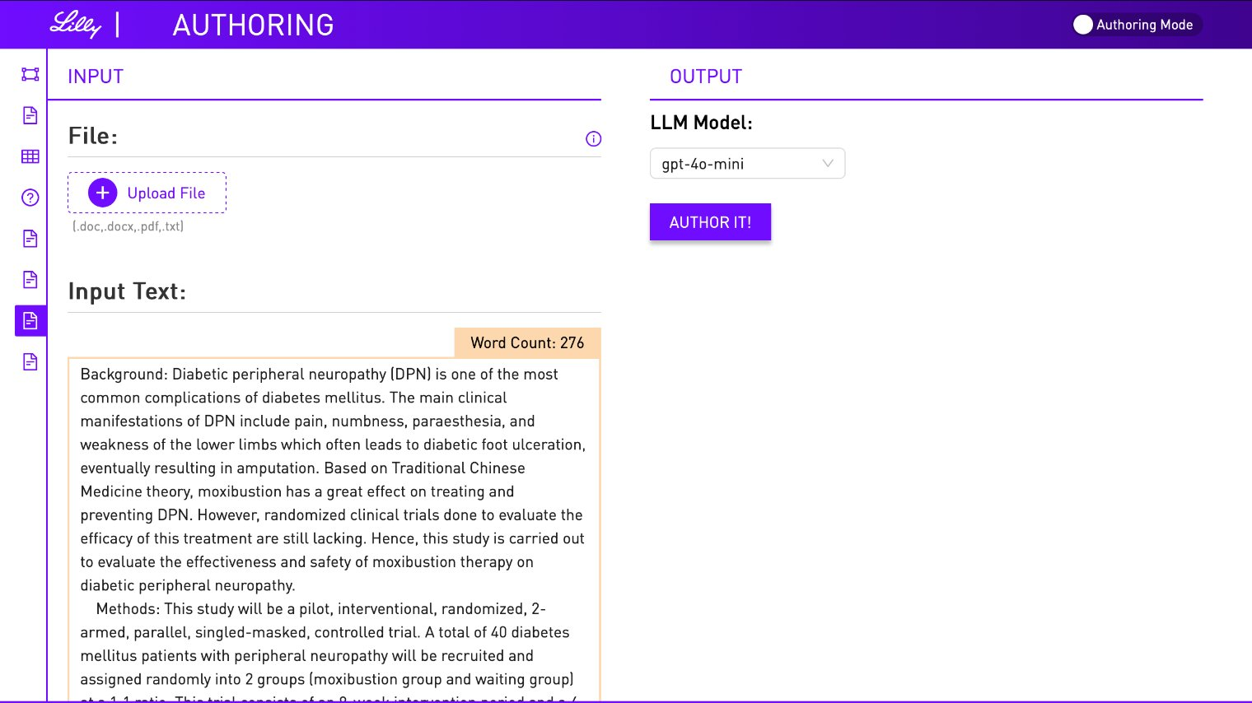
Vue.js
Extraction Page
Developed the Extraction Page and integrated the necessary APIs, enabling users to extract information from any body of text based on their specific constraints and requirements.
This feature strengthens the platform’s capabilities, making it more versatile, user-friendly, and efficient for text-based data extraction.

Slide 5
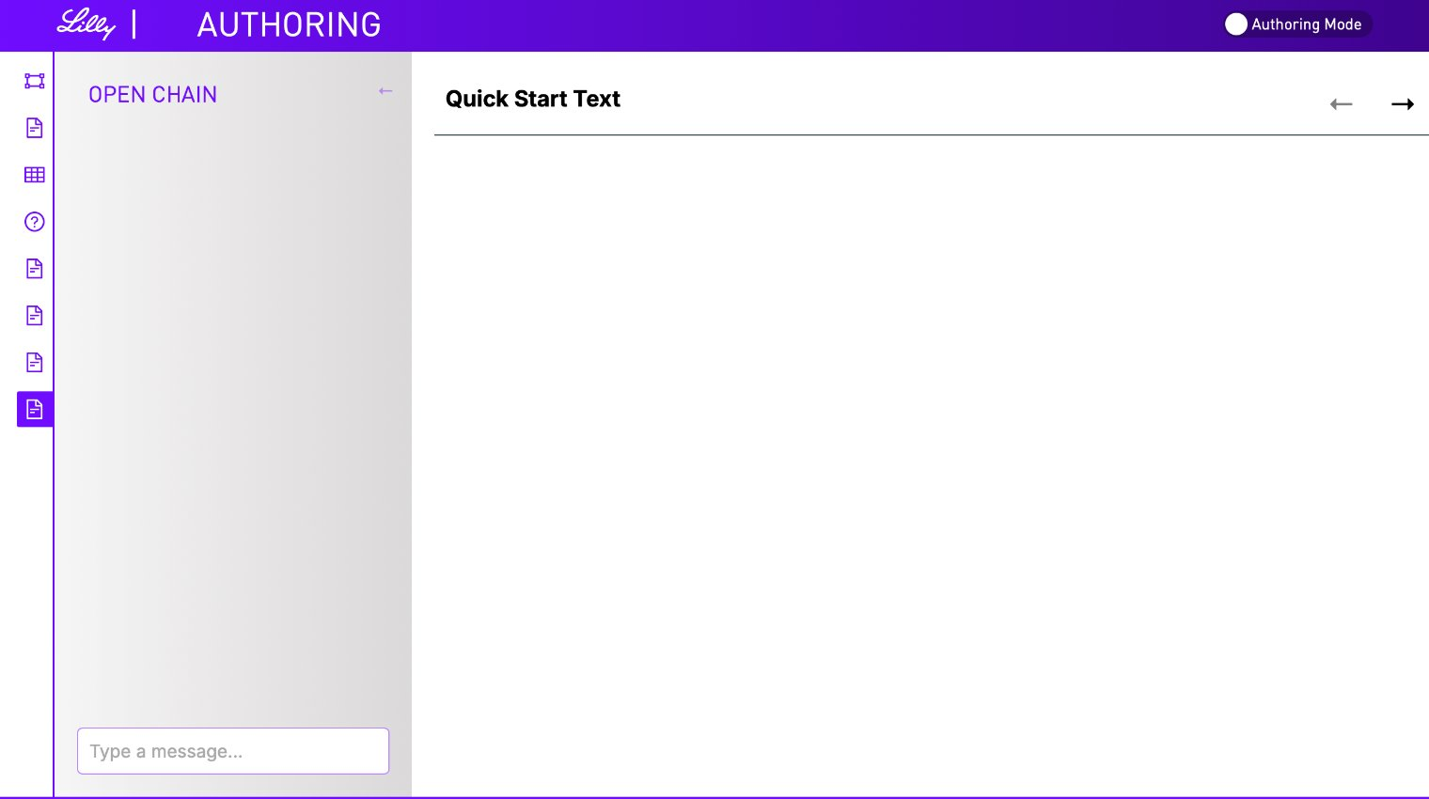
Vue.js
OpenChain Page
Developed the OpenChain UI and built reusable components, enhancing the scalability and maintainability of the project.
This Authoring Studio feature empowers users to generate and modify text, either manually or through an integrated Chatbot.

Slide 6
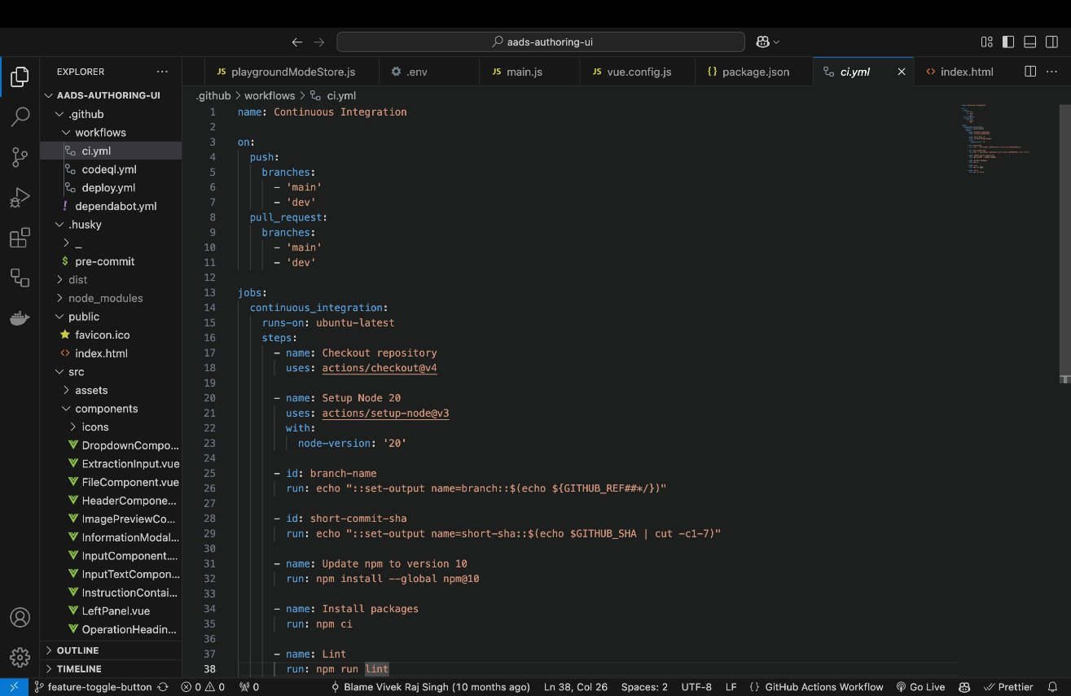
Github CI/CD
Continuous Integration Workflow

Slide 7
This GitHub Actions workflow automates Continuous Integration (CI) by running on every push and pull request to the main and dev branches.
Tasks Performed:
Fetches latest code from the repository, sets up correct version od Node.js for the project
Extracts metadata (current branch and a short commit SHA)
Updates npm
Installs all necessary dependencies
Runs linting and builds the project.
This workflow reduces effort for any developer working on any project since these tasks would normally have been done manually but have been automated using this workflow. This is useful because it can work across all repositories with minor adjustments. It can also support multiple environments. This particular workflow is being used for Node.js but it can be customized for other tech stacks.
By automating CI, this workflow makes development faster, more reliable, and easier to manage, benefiting both individual developers and the organization as a whole.

Slide 8
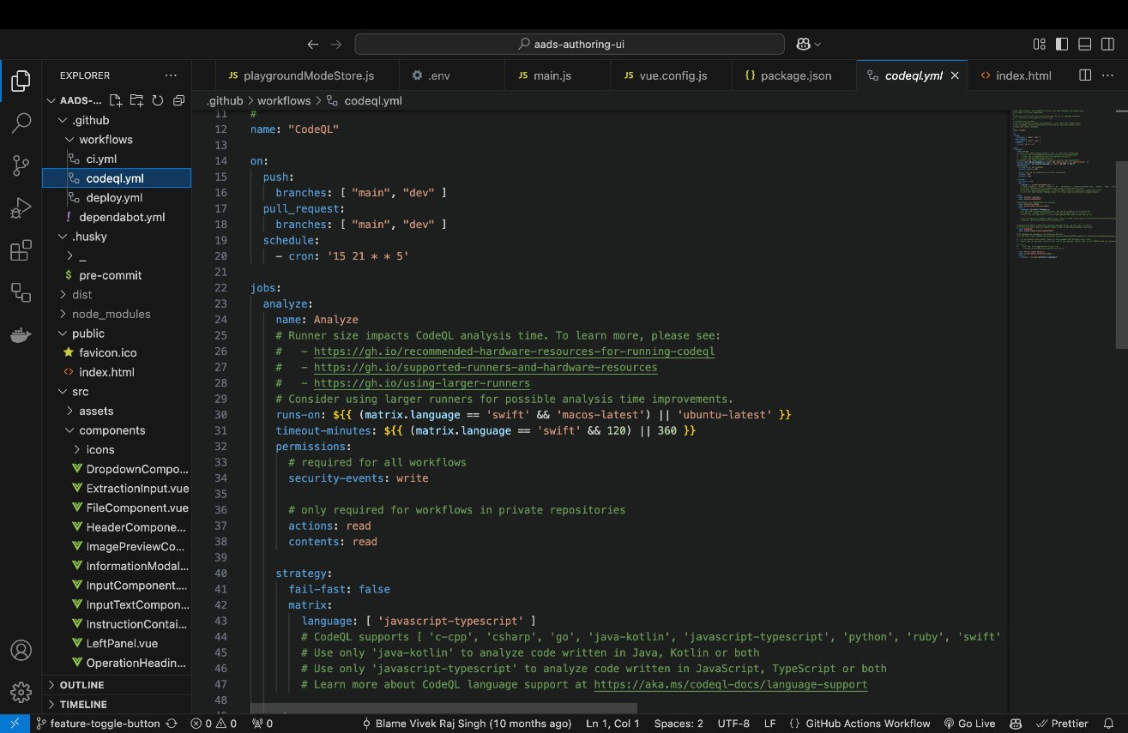
Github CI/CD
CodeQL Workflow

Slide 9
This GitHub Actions workflow automates Code Scanning using CodeQL by running on every push and pull request to the main and dev branches, as well as on a scheduled weekly basis.
Tasks Performed:
Triggers help it to execute on code changes in the main and dev branches or on a weekly schedule
Configures the appropriate runner and allocates sufficient time for analysis based on the language
Grants necessary permissions for security events and repository contents, Analyses JavaScript and TypeScript code by default, but can be extended to support other languages like Python, Ruby, or Go
Uses a matrix to enable multi-language analysis, allowing flexibility for projects with diverse tech stacks.
This workflow automates the process of identifying vulnerabilities and code quality issues, such as SQL injection and cross-site scripting, ensuring that the codebase remains secure and maintainable. It is highly customizable and can be adapted to different languages or repositories with minimal changes.
By integrating CodeQL into the CI pipeline, this workflow enhances the security posture of the project, reduces manual effort, and provides actionable insights for developers, ultimately improving the overall quality and reliability of the codebase.

Slide 10
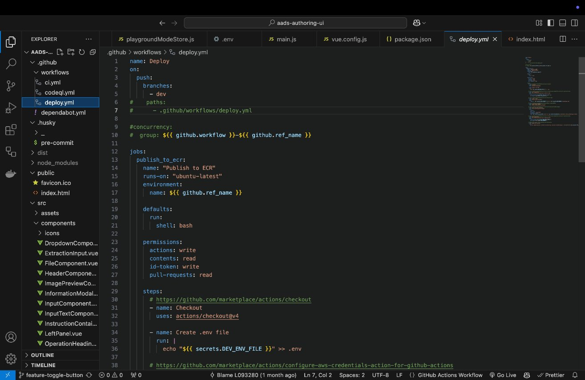
Github CI/CD
Deploy Workflow

Slide 11
This GitHub Actions workflow automates the deployment process for a containerized application to AWS Elastic Container Service (ECS). It ensures that the application is built, pushed, and deployed seamlessly to the cloud.
Tasks Performed:
Login to Amazon Elastic Container Registry (ECR): Authenticates with AWS ECR using credentials stored in GitHub Secrets. Ensures secure access to the private container registry.
Setup Docker Buildx: Configures Docker Buildx, which enables advanced Docker build features like multi-platform builds.
Build and Push Docker Image: Builds the Docker image for the application. Pushes the image to the AWS ECR repository with the latest tag. It also targets the linux/amd64 platform for compatibility.
Configure AWS Credentials: Assumes an AWS IAM role (defined in AWS_DEPLOY_ROLE) to securely access AWS services. Sets the AWS region for deployment.
Update ECS Service: Uses specified task definition to deploy the new container image. It also forces a new deployment to make sure that the latest image is used.
This workflow ensures consistent deployments by automating the process and forcing new deployments. It can also be adapted for other AWS services or environments with minor adjustments.
It simplifies the deployment process, making it faster, more secure, and less error-prone for developers.

Slide 12
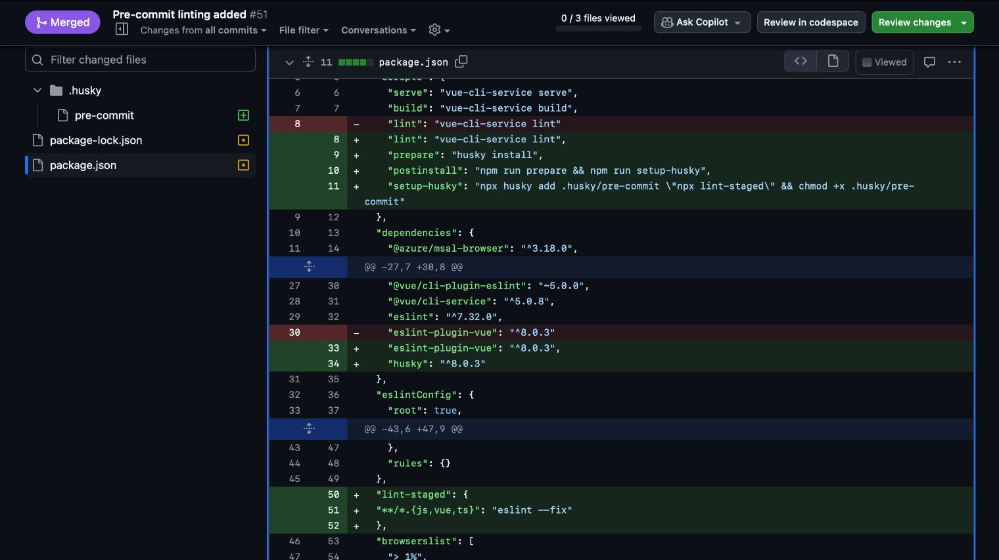
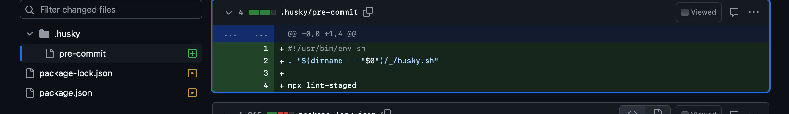
Pre-Commit Lint Checker
Added a Pre-Commit Lint Checker using husky which automatically sets up pre-commit hooks for every developer.
Before any commit, these hooks run linting tools such as ESLint and Prettier to check for syntax errors, code style violations, or any other issues.
This ensures consistent code style and quality across the team. It automates the linting process, saving developers from manually running lint checks.

Slide 13
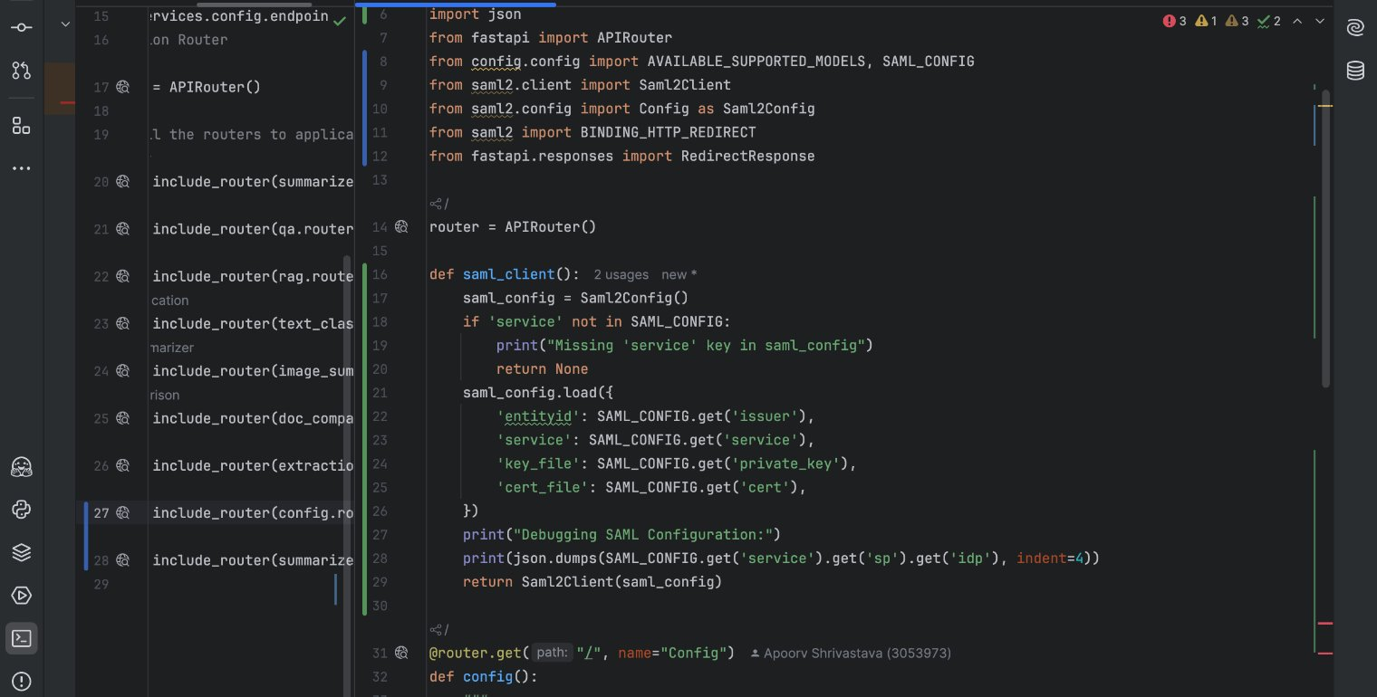
SAML SSO
By integrating SAML SSO, users can log in using their existing credentials from the organization's Identity Provider (IdP). This eliminates the need for maintaining separate credentials for the application, reducing administrative overhead and improving security.
This ensures secure communication between the application and the identity provider. Also, Users can seamlessly access the application without needing to remember additional usernames and passwords.
Azure AD Groups also allow fine-grained control allowing us to determine which users can access the application.

Slide 14
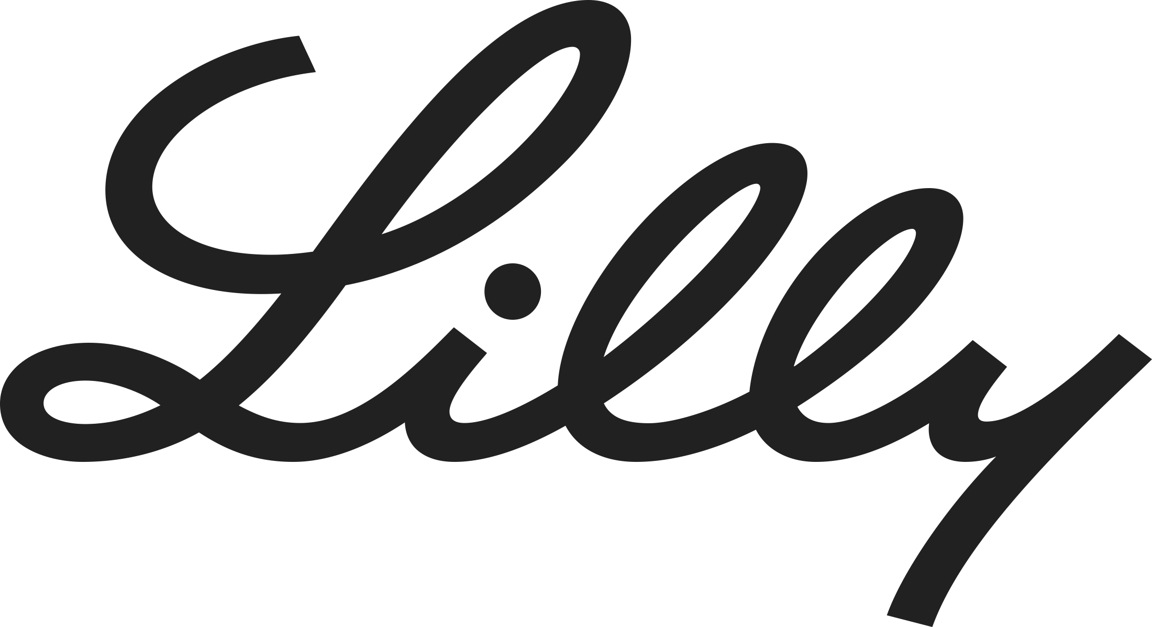
Learnings
Deal Development: Data application in Intelligent Rapid Insight Solution (IRIS) that pulls data from payer customers portals/websites, and other sources into a consolidated central repository to provide data in a consumable form for the business to further perform deal modelling.​
Pharmacy Finder Tableau Report and GLP-1 Inventory Prediction Model: Improves both efficiency and accuracy of inventory management systems as well as pharmacy location services.
Notes:
Title, Content with Two-Thirds Picture at Bottom

Slide 15
LitLENS ("Literature LENS"): It is a search and analytics product for public domain datasets like publications, patents, and clinical trials. It uses NLP techniques, including entity extraction, large language models, and knowledge graphs, for advanced analytical searches.
Notes:
Title, Content with Two-Thirds Picture at Bottom

